Slide 1


Digital Logic and Design

Slide 2


Slides can be found at
https://github.com/sajjo79/Digital-Logic-Design

Slide 3
Analysis of Clocked Sequential Circuits (CSC)
Chapter 4: FlipFlops

Slide 4
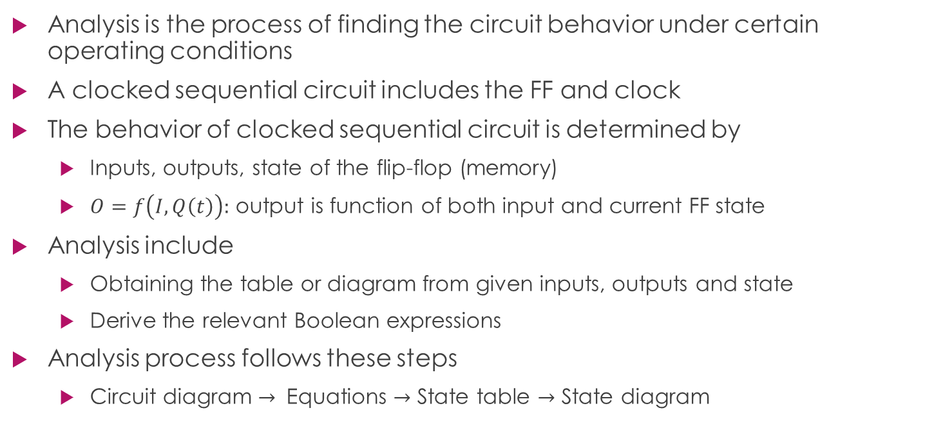
Introduction
Analysis is the process of finding the circuit behavior under certain operating conditions
A clocked sequential circuit includes the FF and clock
The behavior of clocked sequential circuit is determined by
Inputs, outputs, state of the flip-flop (memory)
$O=f\left(I,Q\left(t\right)\right):$ output is function of both input and current FF state
Analysis include
Obtaining the table or diagram from given inputs, outputs and state
Derive the relevant Boolean expressions
Analysis process follows these steps
Circuit diagram $→$ Equations $→$ State table $→$ State diagram
Analysis process
Circuit Diagram
Equations
State Table
State Diagram

Slide 5
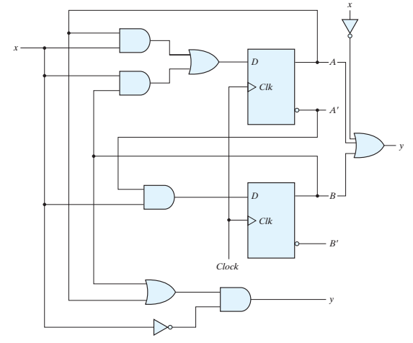
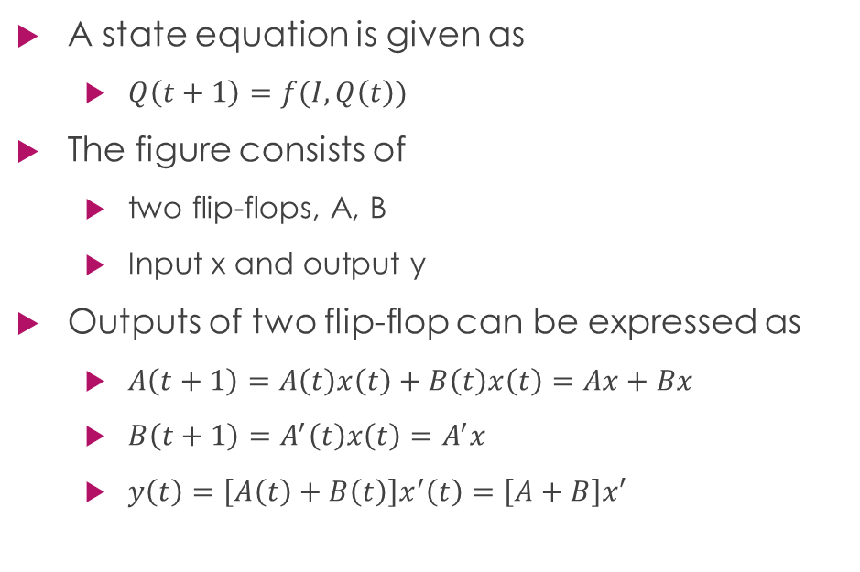
State equations/Transition equations
A state equation is given as
$Q\left(t+1\right)=f(I,Q\left(t\right))$
The figure consists of
two flip-flops, A, B
Input x and output y
Outputs of two flip-flop can be expressed as
$A\left(t+1\right)=A\left(t\right)x\left(t\right)+B\left(t\right)x\left(t\right)=Ax+Bx$
$B\left(t+1\right)=A^{′}\left(t\right)x\left(t\right)=A^{′}x$
$y\left(t\right)=\left[A\left(t\right)+B\left(t\right)\right]x^{′}\left(t\right)=\left[A+B\right]x′$

Slide 6

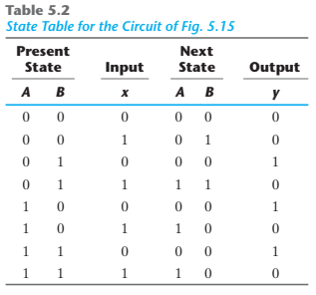
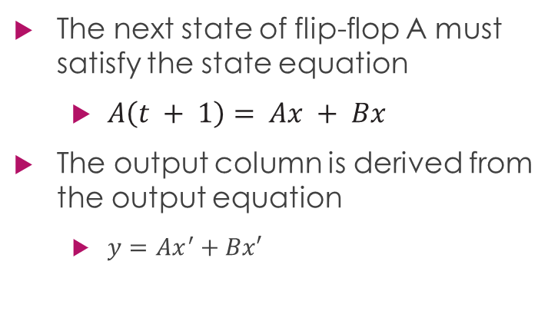
State Table/Transition Table
The next state of flip-flop A must satisfy the state equation
$A\left(t + 1\right)= Ax + Bx$
The output column is derived from the output equation
$y=Ax^{′}+Bx′$

Slide 7
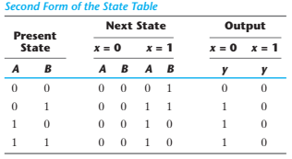
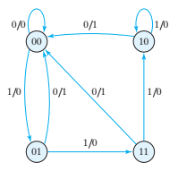
State Diagram/Transition Diagram
Information in state table can also be represented in state diagram
State is represented by a circle and transition is by arrows
The binary number inside each circle identifies the state of the flip-flops
The directed lines are labeled with two binary numbers separated by a slash
Input/output in present state for given input
the directed line from state 00 to 01 is labeled1/0,
when the circuit is in the present state 00 and the input is 1, the output is 0.
After the next clock cycle, the circuit goes to the next state, 01.
If the input changes to 0, then the output becomes 1, but if the input remains at 1, the output stays at 0.
This information is obtained from the state diagram along the two directed lines emanating from the circle with state 01.
A directed line connecting a circle with itself indicates that no change of state occurs.

Slide 9
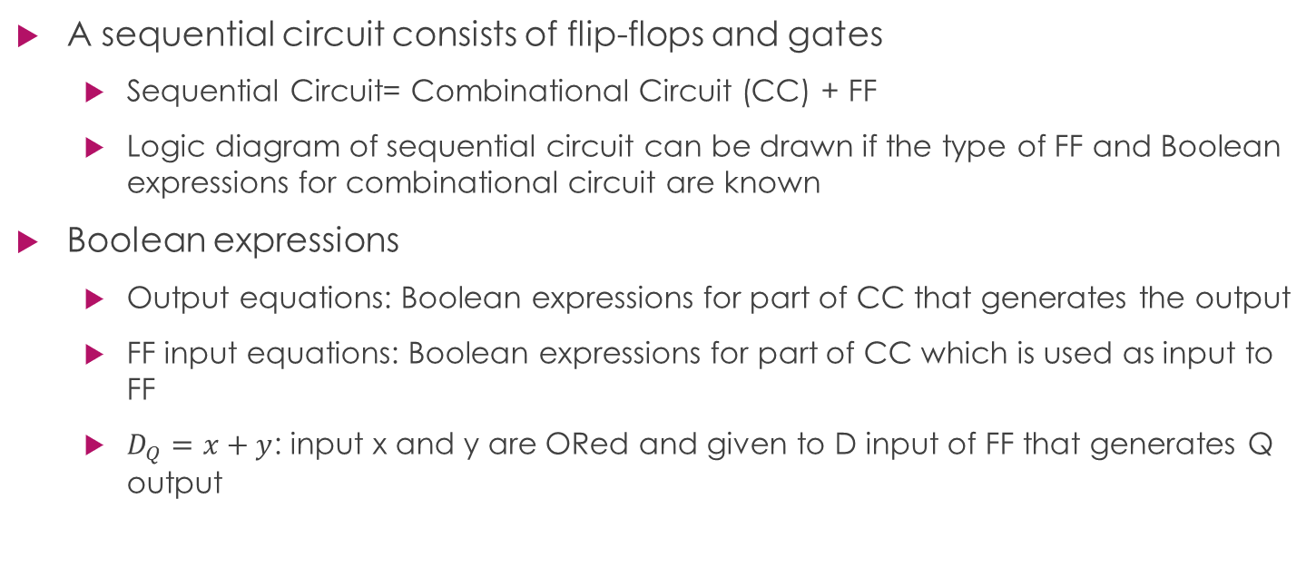
Flip-Flop Input Equations
A sequential circuit consists of flip-flops and gates
Sequential Circuit= Combinational Circuit (CC) + FF
Logic diagram of sequential circuit can be drawn if the type of FF and Boolean expressions for combinational circuit are known
Boolean expressions
Output equations: Boolean expressions for part of CC that generates the output
FF input equations: Boolean expressions for part of CC which is used as input to FF
$D_{Q}=x+y$: input x and y are ORed and given to D input of FF that generates Q output

Slide 10
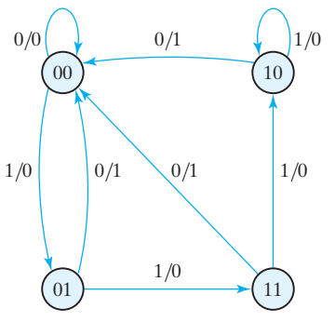

Boolean Expressions for Sequential Circuit
The sequential circuit consists of two D Flip-Flops A and B
There are two input variables $x,y$
Logic circuit representation
$D_{A}=Ax+Bx$
$D_{B}=Ax$
$y = (A+B)x$

Slide 11
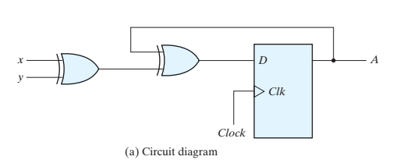
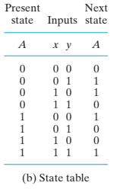
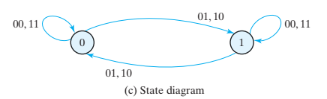
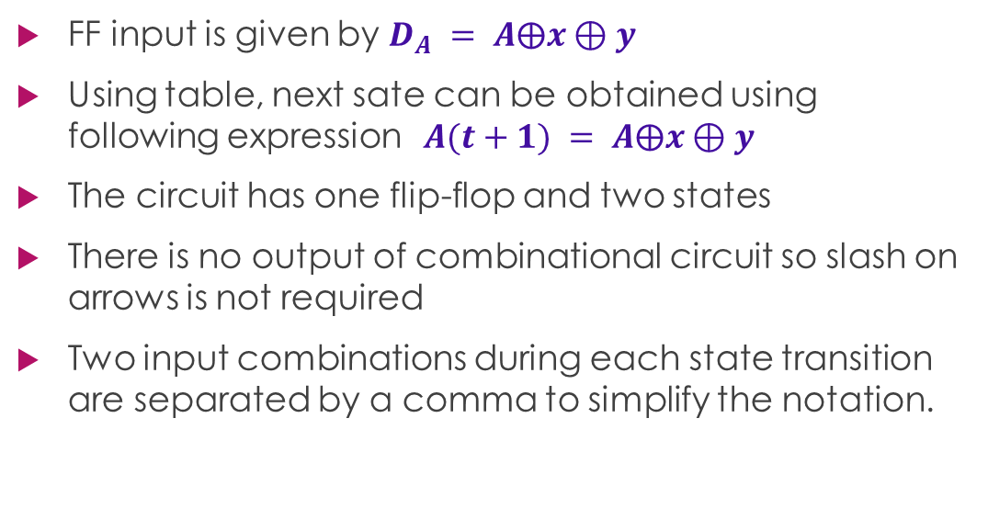
Analysis with D Flip-Flop
FF input is given by $D_{A} = A⨁x⊕y$
Using table, next sate can be obtained using following expression $A(t+1) = A⨁x⊕y$
The circuit has one flip-flop and two states
There is no output of combinational circuit so slash on arrows is not required
Two input combinations during each state transition are separated by a comma to simplify the notation.
Sequential Circuit with D Flip Flop

Slide 12
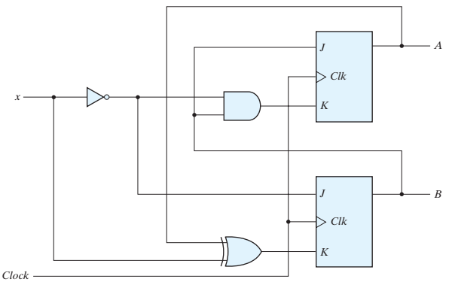
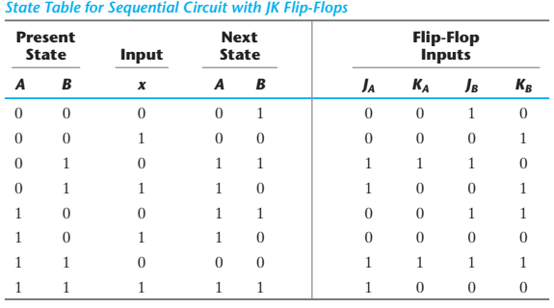
Analysis with JK Flip Flop
The state table has four sections
Present state, inputs, next state, outputs
First two are obtained by listing all binary combinations
Next-state values are evaluated from the state equations
Corresponding characteristic table or equations are used to obtain next state values
Steps to obtain next state values
Determine the FF input equations
List binary values of each input equation
Use FF characteristic table to obtain next state values

Slide 13
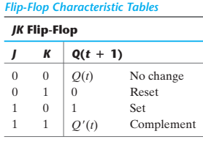
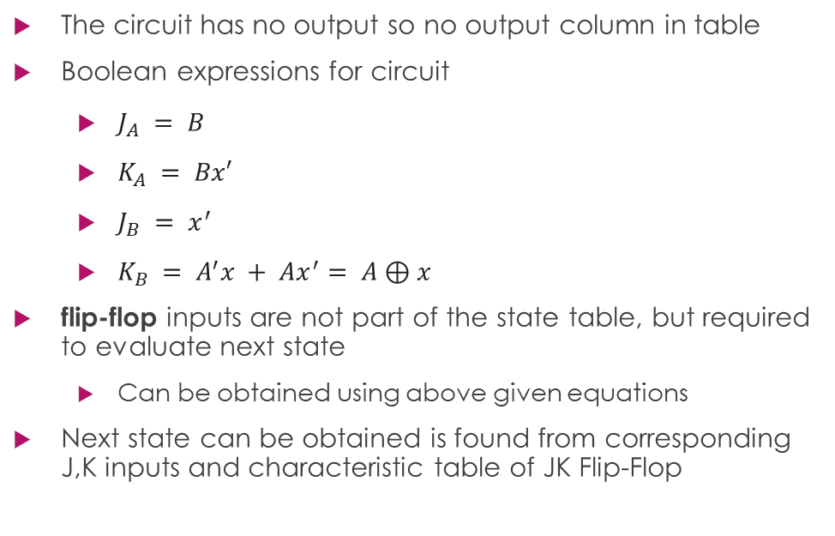
Analysis of JK Flip-Flop
The circuit has no output so no output column in table
Boolean expressions for circuit
$J_{A} = B$
$K_{A} = Bx′$
$J_{B} = x^{′}$
$K_{B} = A^{′}x + Ax^{′}= A⊕x$
flip-flop inputs are not part of the state table, but required to evaluate next state
Can be obtained using above given equations
Next state can be obtained is found from corresponding J,K inputs and characteristic table of JK Flip-Flop

Slide 14

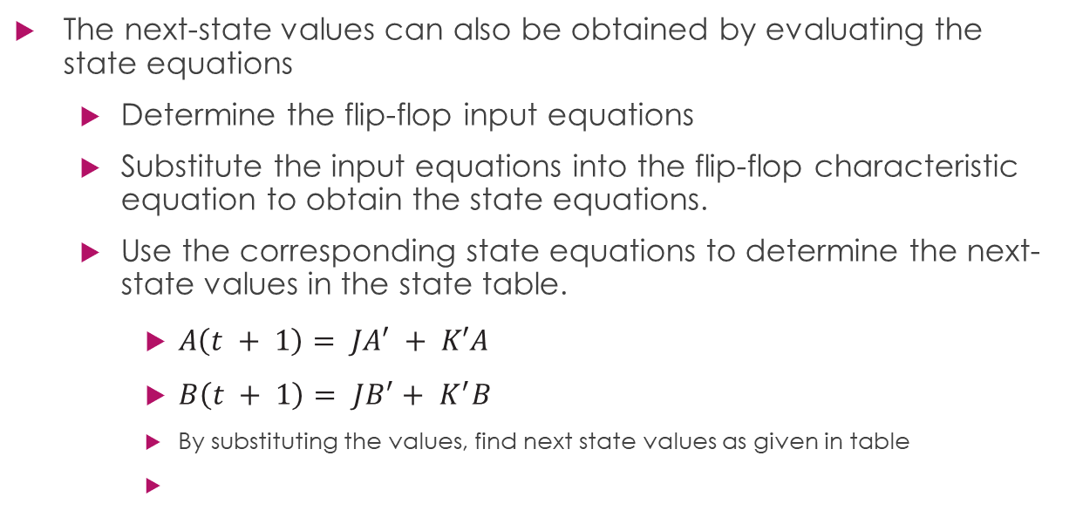
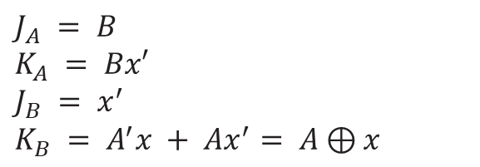
Analysis of JK Flip Flop
The next-state values can also be obtained by evaluating the state equations
Determine the flip-flop input equations
Substitute the input equations into the flip-flop characteristic equation to obtain the state equations.
Use the corresponding state equations to determine the next-state values in the state table.
$A\left(t + 1\right)= JA′ + K′A$
$B\left(t + 1\right)= JB^{′}+ K^{′}B$
By substituting the values, find next state values as given in table
$$\begin{aligned}A\left(t + 1\right)= BA^{′}+ {\left(Bx^{′}\right)}^{′}A = A^{′}B + AB^{′}+ Ax\#\#\#(1)\end{aligned}$$
$$J_{A} = B$$
$$K_{A} = Bx′$$
$$J_{B} = x^{′}$$
$$K_{B} = A^{′}x + Ax^{′}= A⊕x$$
$$\begin{aligned}B\left(t + 1\right)= x^{′}B^{′}+ {\left(A⊕ x\right)}^{′}B = B^{′}x^{′}+ ABx + A^{′}Bx^{′}\#\left(2\right)\end{aligned}$$

Slide 15
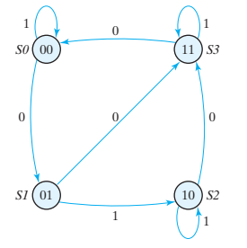

Slide 16
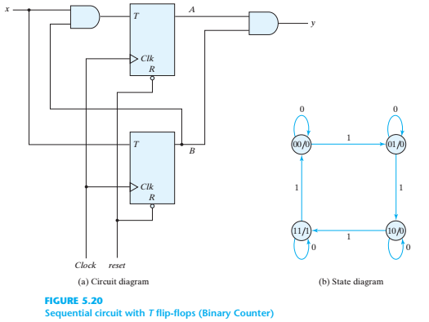
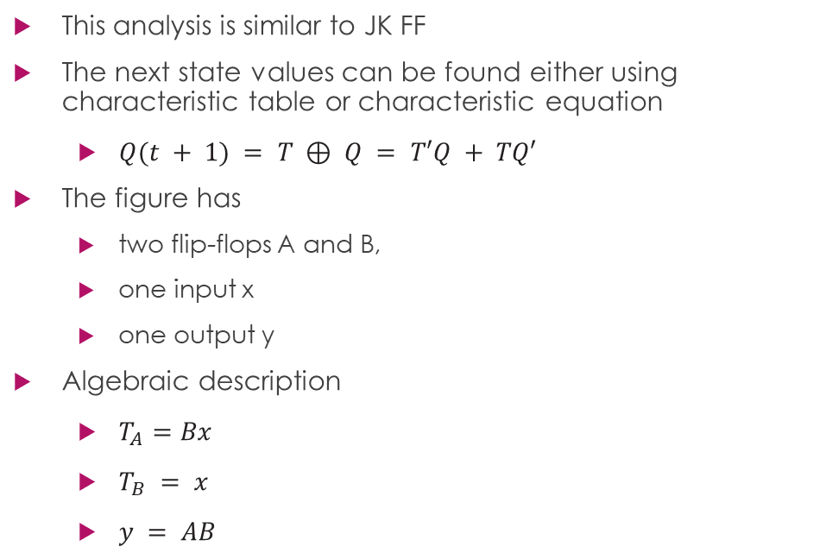
Analysis with T Flip-Flop
This analysis is similar to JK FF
The next state values can be found either using characteristic table or characteristic equation
$Q(t + 1) = T ⊕ Q = T′Q + TQ′$
The figure has
two flip-flops A and B,
one input x
one output y
Algebraic description
$T_{A}=Bx$
$T_{B} = x$
$y = AB$

Slide 17
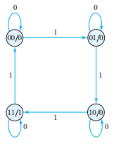
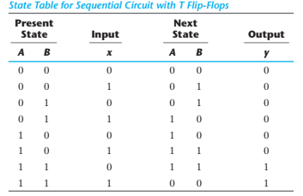
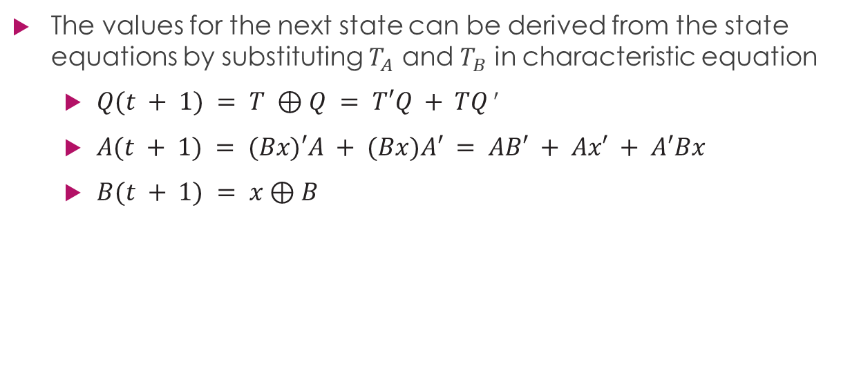
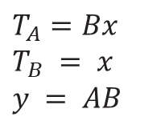
The values for the next state can be derived from the state equations by substituting $T_{A}$ and $T_{B}$ in characteristic equation
$Q(t + 1) = T ⊕Q = T′Q + TQ ′$
$A(t + 1) = (Bx)′A + (Bx)A′ = AB′ + Ax′ + A′Bx$
$B(t + 1) = x⊕B$
$$T_{A}=Bx$$
$$T_{B} = x$$
$$y = AB$$

Slide 18
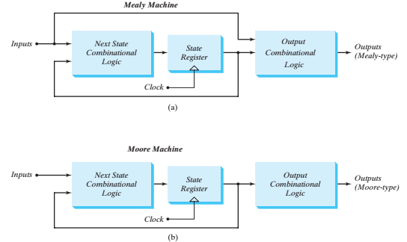
Mealy and Moore Models for Finite State Machines
The two models of a sequential circuit are commonly referred to as a finite state machine (FSM)
The most general model of a sequential circuit has inputs, outputs, and internal states
Mealy and Moore differ only in the way the output is generated
Mealy model: the output is a function of both the present state and the input
Moore model: the output is a function of only the present state
A circuit may have both types of outputs.

Slide 19
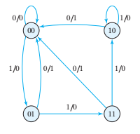
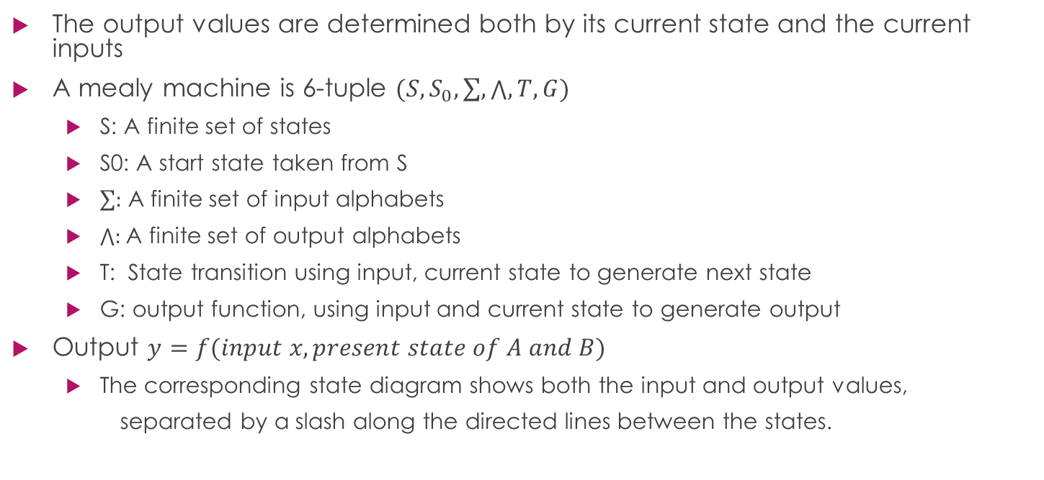
Mealy Machines – Mealy FSM
The output values are determined both by its current state and the current inputs
A mealy machine is 6-tuple $(S,S_{0},\sum{,}\bigwedge{,}T,G)$
S: A finite set of states
S0: A start state taken from S
$\sum{:}$ A finite set of input alphabets
$\bigwedge{:}$A finite set of output alphabets
T: State transition using input, current state to generate next state
G: output function, using input and current state to generate output
Output $y=f(input x, present state of A and B)$
The corresponding state diagram shows both the input and output values,
separated by a slash along the directed lines between the states.

Slide 20
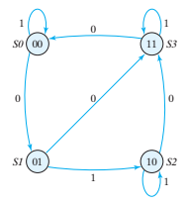
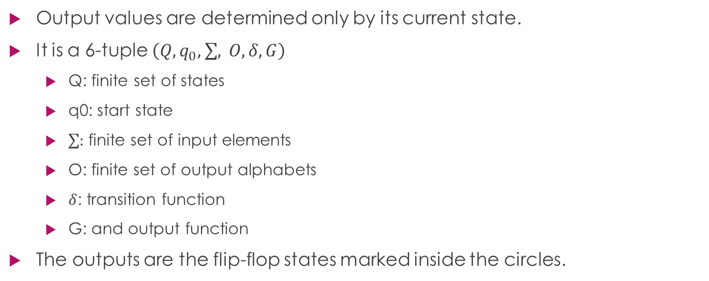
Moore Machine – Moore FSM
Output values are determined only by its current state.
It is a 6-tuple $\left(Q,q_{0},\sum{,} O,δ, G\right)$
Q: finite set of states
q0: start state
$\sum{:}$ finite set of input elements
O: finite set of output alphabets
$δ$: transition function
G: and output function
The outputs are the flip-flop states marked inside the circles.

Slide 21
In a Moore model, the outputs of the sequential circuit are synchronized with the clock
In a Mealy model, the outputs may change if the inputs change during the clock cycle

Slide 22
22
Thanks for watching
Dr. Sajid Iqbal
Assistant Professor
Department of Computer Science
Bahauddin Zakariya University, Multan
Allah Hafiz
Slides are available at: https://github.com/sajjo79/Digital-Logic-Design

